Slide 1
Link Analysis Introduction
Greg Tam – Data Scientist

Slide 2
Link Analysis
What is link analysis?
Creating associations between different entities
In our case, we are using it to identify candidates for fraud
Example:
Identifying non-fraud account creations created on the same device as fraudulent accounts

Slide 3
Tools
Impala
Gephi – A program that interactively visualizes graphs
NetworkX – A Python library for creating and manipulating graphs
(This is technically optional, but allows for much more functionality)

Slide 4
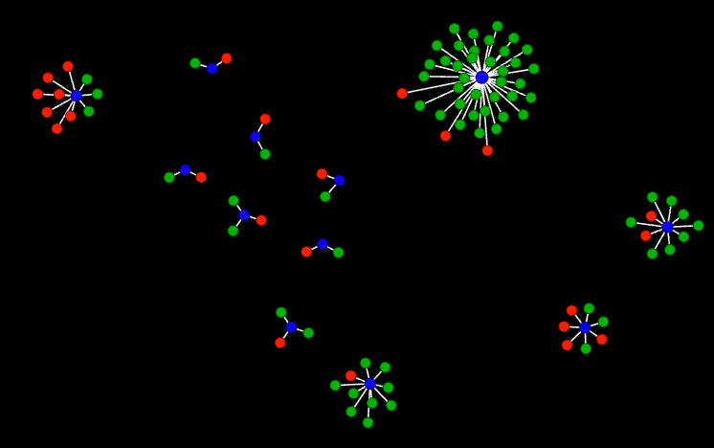
Gephi
Red: Fraud
Green: Non-Fraud
Blue: Smart ID
Graphs in Gephi can be created from a number of formats:
List of edges and nodes (CSV)
GEXF (Graph Exchange XML Format) file
Adjacency list (CSV)
Adjacency matrix (CSV)
We will focus on the first two

Slide 5
Simple Example (CSV)
Nodes Table
CSV file containing the nodes and any of their associated properties
Node type property allows us to specify different colours when visualizing
Id | Label | Node Type
a_1 | a_1 | Non-Fraud
a_2 | a_2 | Fraud
a_3 | a_3 | Fraud
a_4 | a_4 | Non-Fraud
a_5 | a_5 | Non-Fraud
d_1 | d_1 | Smart ID
d_2 | d_2 | Smart ID
Edges Table
CSV file containing the edges that link two nodes
“Type” column indicates that there is no directionality associated with the nodes
Source | Target | Type
a_1 | d_1 | Undirected
a_2 | d_1 | Undirected
a_3 | d_1 | Undirected
a_4 | d_2 | Undirected
a_5 | d_2 | Undirected

Slide 6
Simple Example (NetworkX)
Basic workflow
Import NetworkX (import networkx as nx)
Create a graph using nx.Graph()
Add nodes using the add_nodes() method
Add edges using the add_edges() method
Save the graph as a GEXF file using nx.write_gexf(G, filename)
Example Code:
# Initialize graph
test_graph = nx.Graph()
# Add nodes to the graph
for i, row in nodes_df.iterrows():
test_graph.add_node(row['Id'], node_type=row['Node Type'])
# Add edges to the graph
for i, row in edges_df.iterrows():
test_graph.add_edge(row['Source'], row['Target'])
# Save the graph to a GEXF file
nx.write_gexf(test_graph, 'test_example_graph.gexf')

Slide 7
Gephi

